Slide 1
MCDA 5550 - Web App Development Chapter 03: Introduction to forms, JavaScript, jQuery mobile
Instructor: DINESH KG

Slide 2
Designing an app
Target users
User tasks, NOT what you want them to do
Communication: instructions, feedback, alert, confirmation, etc
User Study Designs
beyond the scope of this course -> MCDA5530 : HCI
Common sense still applies -> if your app looks messy and hard to use, you should redesign!

Slide 3
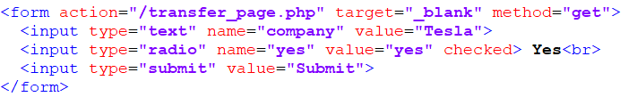
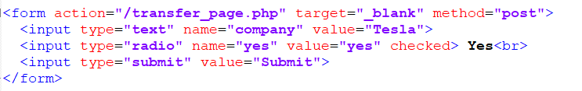

Forms

Slide 4
JavaScript
HTML/CSS do not provide a full range of interactions
JavaScript ≠ Java
Compiling vs Interpretation
Client-side vs Server-side scripting
JavaScript originally used only for client-side
Libraries: jQuery (client-side), Node.js (server-side)

Slide 5
DOM: Document Object Model
Each component in HTML is an “object” in JavaScript
Each object is associated with properties (variables/constants) and actions (functions)
Specifies the hierarchical structure of the document

Slide 6
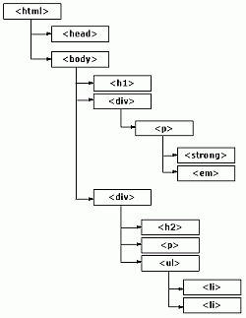

Slide 7
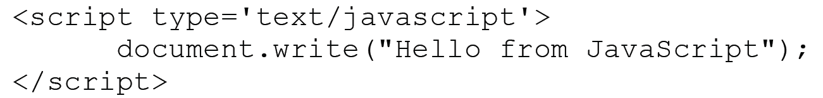
Document object in HTMLs
document is an object representing the current HTML document
write is a function to write to the HTML page
"Hello from JavaScript" is an argument to the function

Slide 8
Cont’d
write can take tags
e.g.)
document.write(
"<strong>Hello</strong> from JavaScript“
);
i.e., you could write a formatted HTML from JavaScript on the fly!

Slide 9
Example:
document.write("<table width='200' border='1'>");
document.write(" <tr>");
document.write(" <td>Hi</td>");
document.write(" <td>Yeah</td>");
document.write(" <td>No</td>");
document.write(" </tr>");
document.write(" <tr>");
document.write(" <td>OK</td>");
document.write(" <td>Good</td>");
document.write(" <td>Bad</td>");
document.write(" </tr>");
document.write("</table>");

Slide 10
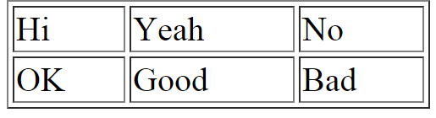
Output

Slide 11
.js file
Separate JavaScript code from HTML
<script type='text/javascript' src='scripts/simple.js'></script>
Works as before

Slide 12
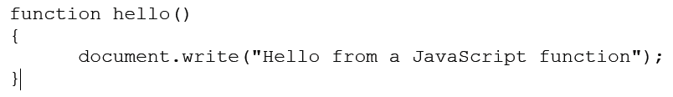
JavaScript Functions
Syntax:
function nameOfFunction(arg1, arg2){
//body of the function
}
No return type
No data type for arguments

Slide 13
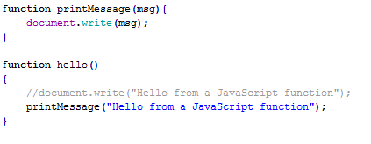
Cont’d

Slide 14

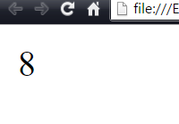
Cont’d

Slide 15
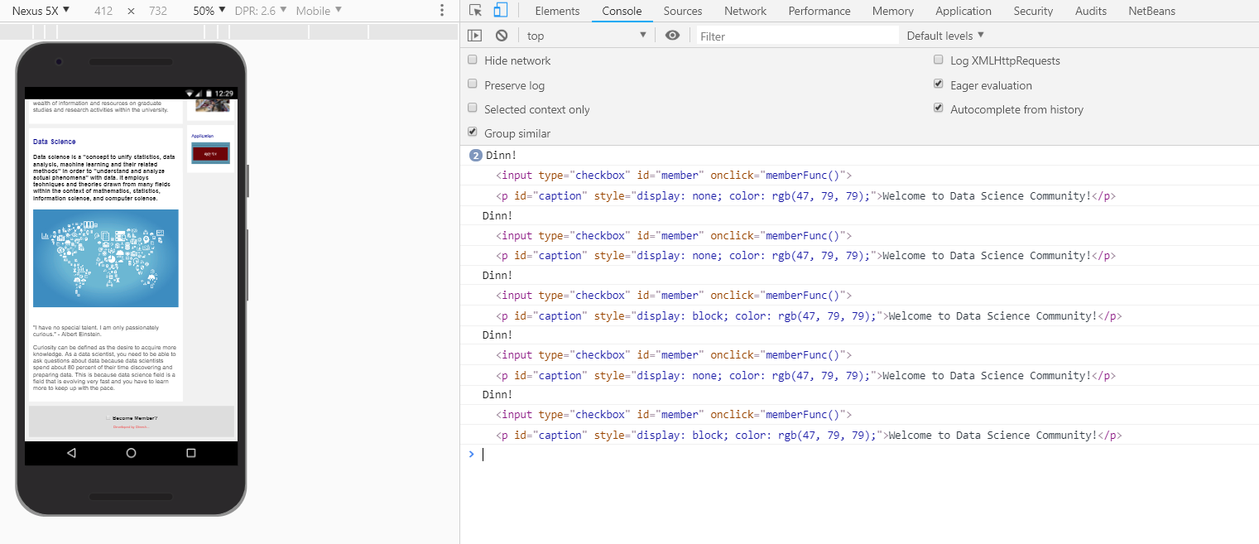
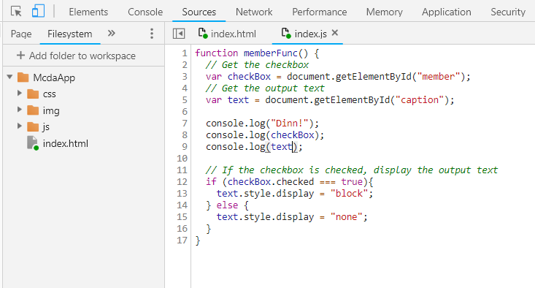
JavaScript console

Slide 16
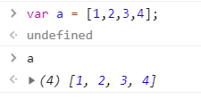
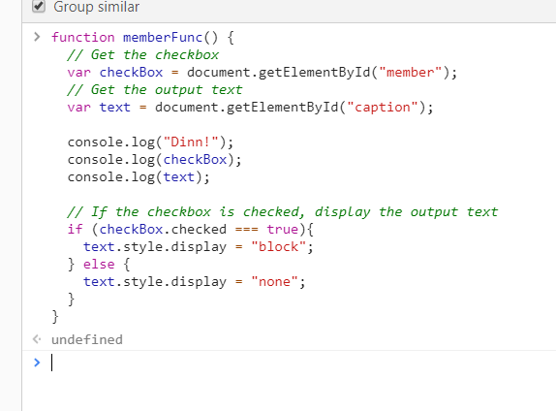
JavaScript console
Type line by line
Or copy/paste (functions etc)

Slide 17
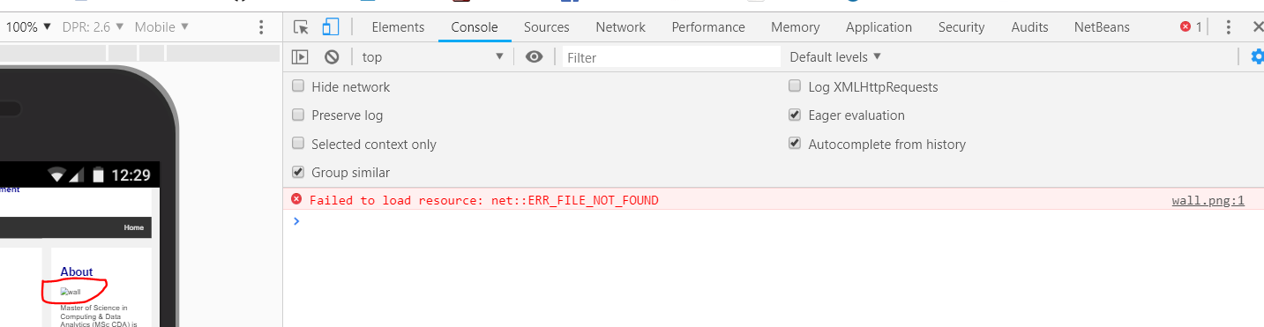
If errors…
Use it to investigate!

Slide 18
jQuery
A collection of JavaScript functions
Makes complex operations simpler
jQuery mobile framework:
“Write less, do more”
Design that works for different platforms (with very minimal modifications if any)
jQuery mobile css

Slide 19
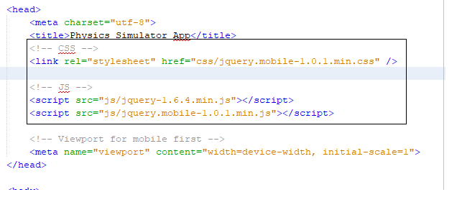
Download to your web server

Slide 20
… or link to online resources
<!-- CSS -->
<link rel="stylesheet" href="http://code.jquery.com/mobile/1.0.1/jquery.mobile-1.0.1.min.css" />
<!-- JS -->
<script src="http://code.jquery.com/jquery-1.6.4.min.js"></script>
<script src="http://code.jquery.com/mobile/1.0.1/jquery.mobile-1.0.1.min.js"></script>
NB: The code examples in the textbook are based on these versions. Some functions in these examples will not work in the newer versions.

Slide 21
meta tags
Provides data (information) about data (HTML document).
page description, keywords, author of the document, last modified, and other metadata.
Always inside the <head> element.
Passed as name/value pairs.

Slide 22
viewport
<meta name="viewport" content="width=device-width, initial-scale=1.0">
Information on how to control the page's dimensions and scaling
width=device-width sets the width of the page to follow the screen-width of the device
initial-scale=1.0 sets the initial zoom level

Slide 23
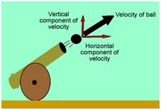
Our 1st app
Physics Simulator app
Calculate distance of a projectile based on angle and velocity input by the user

Slide 24
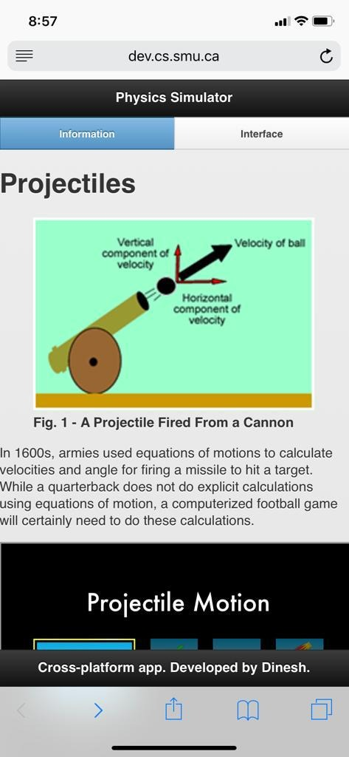
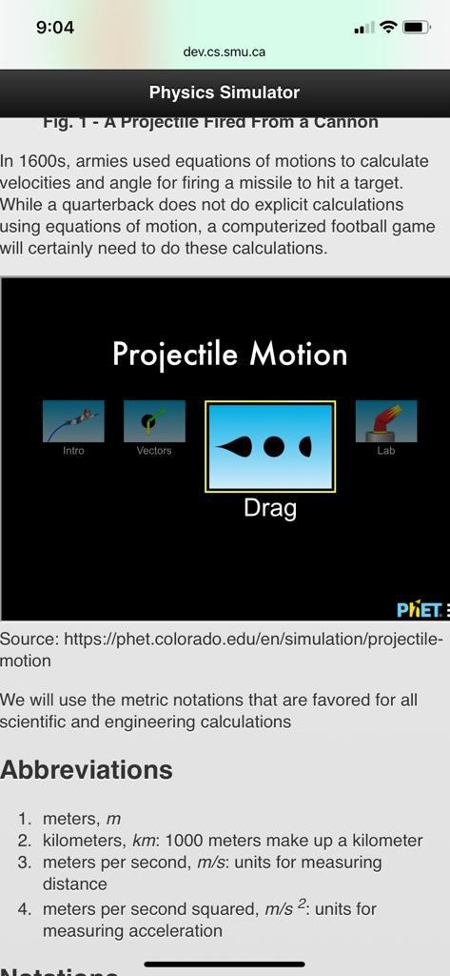
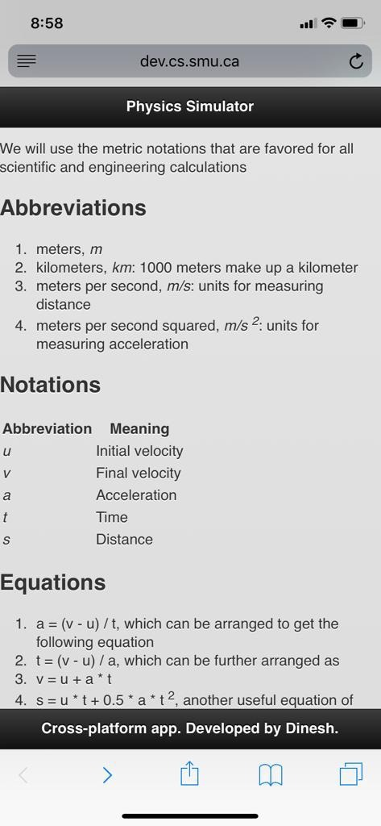

Slide 25
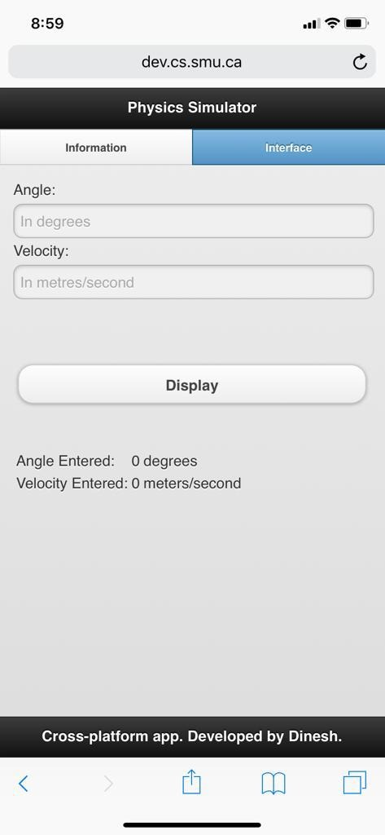
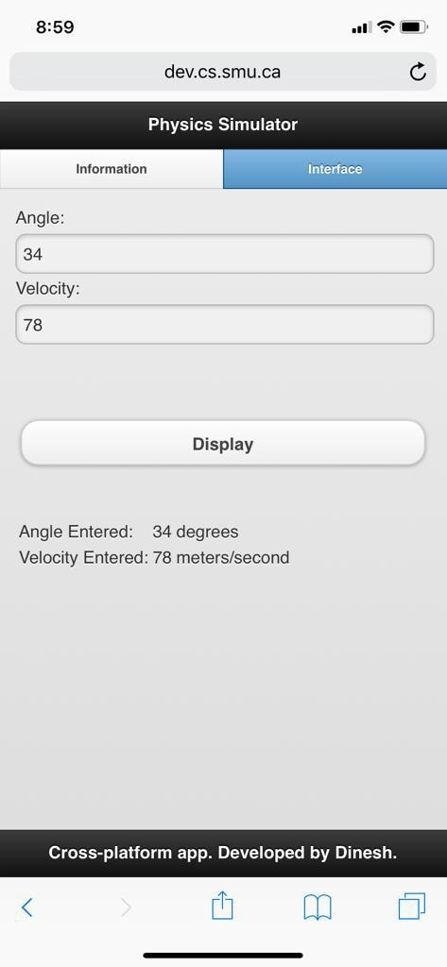

Slide 26
header, footer, and content data-role
data-role in <div>
page: displays contents in a single page
header
content
footer

Slide 27
<div data-role="page">
<div data-role = header>Physics Simulator App</div>
<div data-role="content">
…… content of the page ….
</div>
<div data-role = footer>
<small>Cross-platform mobile app demo. Developed by Dinesh.</small>
</div>
</div>

Slide 28
Text formatting tags (review)
<b> bold
<i> italic
<small> smaller
<sub> subscripted
<sup> superscripted
<del> strikethrough
<mark> highlighted
(and more…)

Slide 29
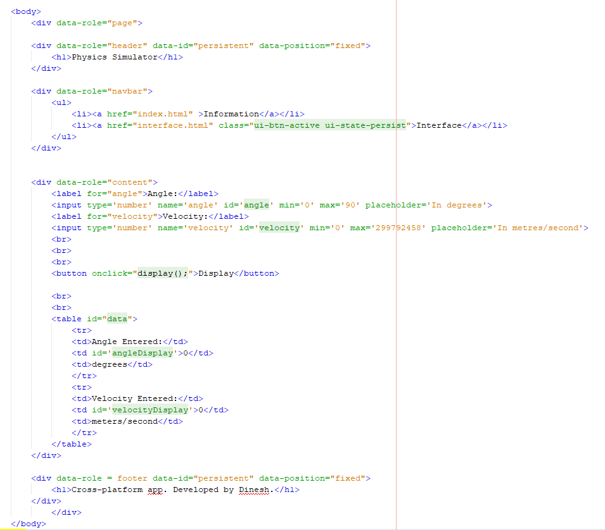

Slide 30
Widgets
Provided by jQuery mobile stylesheet and libraries
http://api.jquerymobile.com/category/widgets/

Slide 31
<input></input>
type : password, email, tel, number, and many more (sometimes browser-dependent)
name: (obsolete/deprecated for some tags), is replaced by the id attribute
id: identify an element, preferred way to identify an element and must be unique in a given document

Slide 32
<input></input>
min/max: specifies the range, not relevant to some types
placeholder: initial text that appears in the element, will be replaced by the actual input value, when the user types it.

Slide 33
<label> </label>
Label for widgets
for to specify which widget it’s for
<label for="angle">

Slide 34
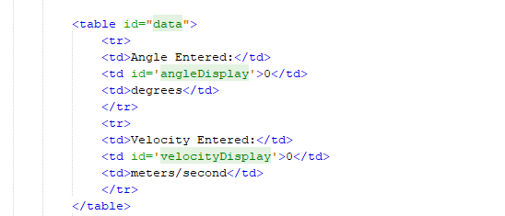
Output

Slide 35
onload, onclick, etc
HTML DOM events (http://www.w3schools.com/jsref/dom_obj_event.asp)
Elements “listen” to events
e.g.)
onload occurs when the object is loaded
onclick occurs when the user clicks on the object
Essential for WIMP (windows, icons, menus, pointer) style interactions

Slide 36

Cont’d
Specify what happens when an event with the element occurs
display() is a JavaScript function
Can be multiple lines and they don’t have to be functions.

Slide 37
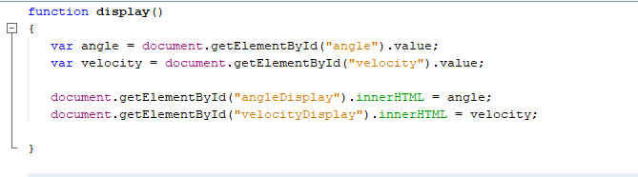
display() function

Slide 38
Variables in JavaScript
Create variables using var
JavaScript has “dynamic” data types:
var x; // x is undefined
var x = 20; //x is a Number
var x = “Hello"; // now x is a String
YOU are responsible for type casting:
var x = 2 + “5”; // x is a String
var x = 2 + 5; // x is a Number

Slide 39
getElementById(“targetId”)
One way to access elements in the document (there are other ways)
Searches in the document to find a corresponding element with the specified id
HTML elements are represented as “objects” in JavaScript

Slide 40
Cont’d
document.getElementById("angle") will return an element object (its id is “angle”)
Use . to access the object’s properties (e.g., name, id, value, etc) or run associated functions
document.getElementById("angle").value will return a value of the element with the id “angle”
i.e.) the value the user types in the input box for the angle

Slide 41
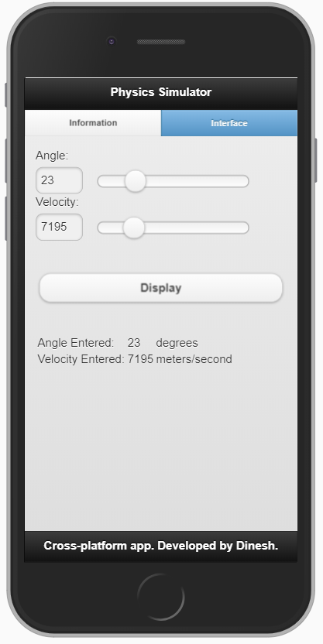
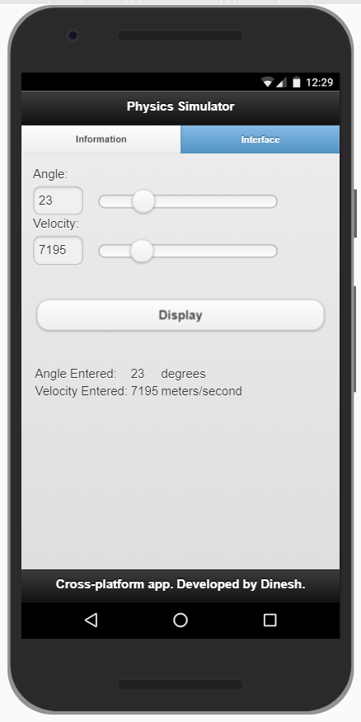
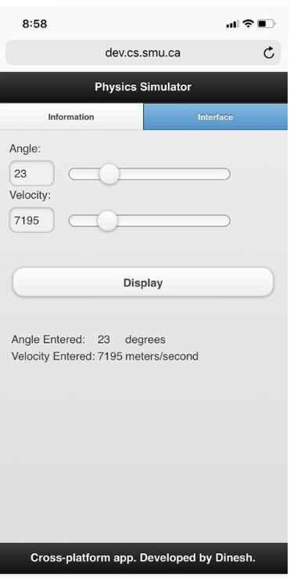
Navigation bar & Slider
iPhone6
Nexus
iPhone XR

Slide 42
<div data-role="navbar">
<ul>
<li><a href="index.html" class="ui-btn-active ui-state-persist">Information</a></li>
<li><a href="interface.html" >Interface</a></li>
</ul>
</div>
<label for="angle">Angle:</label>
<input type='range' name='angle' id='angle' min='0' max='90'>
<label for="velocity">Velocity:</label>
<input type='range' name='velocity' id='velocity' min='0' max='29979'>

Slide 43
<h1>Projectiles</h1>
<figure>
<img src="img/projectile.png" alt="A Cannon Firing a Projectile" width="333" height="228">
<figcaption><strong>Fig. 1 - A Projectile Fired From a Cannon</strong></figcaption>
</figure>
<p>In 1600s, armies used equations of motions to calculate
velocities and angle for firing a missile to
hit a target. While a quarterback does not do explicit calculations using equations of motion,
a computerized football game will certainly need
to do these calculations.
</p>
<iframe src="https://phet.colorado.edu/sims/html/projectile-motion/latest/projectile-motion_en.html" width="420" height="315" scrolling="no" allowfullscreen>
</iframe>
<p>
We will use the metric notations that are favored for
all scientific and engineering calculations
</p>

Slide 44
Class Activity
Use the code above to refer.
Redevelop the same app. (Video element is not required)
Place the project on server under your id!

